Slide 1
Project Proposal
Samiur Rahman Prapon, Md Habibullah, Shahriar Hossain

Slide 2
INTRODUCTION
Source: https://statisticstimes.com/demographics/world-sex-ratio.php

Slide 3
Fact
While men do have a chance of getting the disease, 99% of breast cancer patients are women.

Slide 4
Breast cancer risk Factor
​ | handedness | Wrong Size wearable | Right size wearable​
12-18 years | - | - | -
18-50 years | 50%(left-sided cancer) | Higher risk | Low risk
Source: https://doi.org/10.1016/0277-5379(91)90469-T

Slide 5
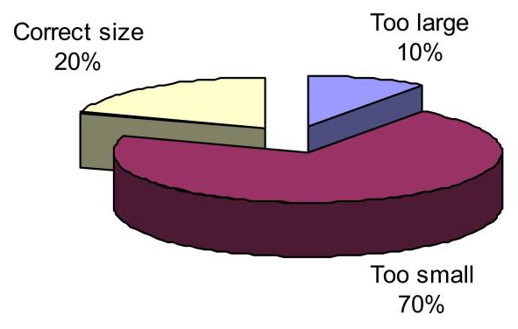
Alarming FACT 80% of women wearing wrong size BRA !
Source: https://doi.org/10.1080/00140139.2011.647096
https://chiromt.biomedcentral.com/articles/10.1186/1746-1340-16-1
Image : https://www.ncbi.nlm.nih.gov/pmc/articles/PMC2275741/

Slide 6
Solve one of the key factor of breast cancer
Followed by this paper https://link.springer.com/chapter/10.1007/978-3-540-78948-2_11

Slide 7
Solution: Predicting Breast Size & Determining Bra Size
Image
Add size label
train
Generate
model

Slide 8
Road blocks
Have no database (but we can built one with the help of models)
Don’t know how to work with images (Before we start this topic, we can built one mean time.)

Slide 9
Thank You

